Slide 1
Component Lifecycle

Slide 2
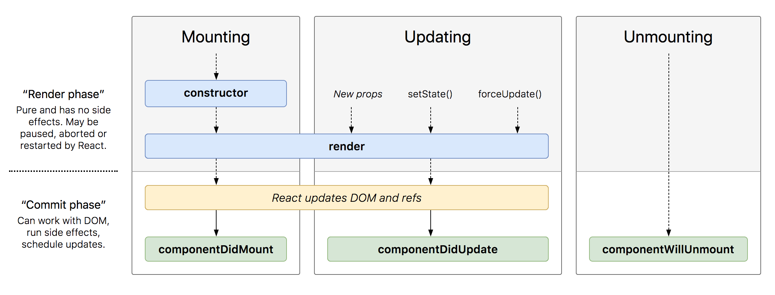
Lifecycle diagram
Notes:
Each component has several “lifecycle methods” that you can override to run code at particular times in the process.

Slide 3
Mounting
These methods are called in the following order when an instance of a component is being created and inserted into the DOM:
constructor()
static getDerivedStateFromProps()
render()
componentDidMount()

Slide 4
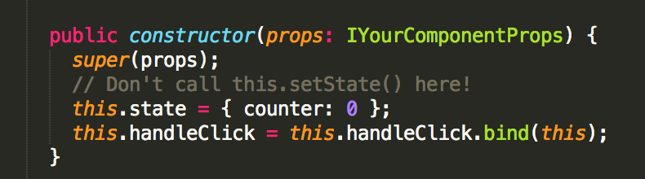
Constructor
Typically, in React constructors are only used for two purposes:
Initializing local state by assigning an object to this.state.
Binding event handler methods to an instance.
Notes:
If you don’t initialize state and you don’t bind methods, you don’t need to implement a constructor for your React component.
The constructor for a React component is called before it is mounted. When implementing the constructor for a React.Component subclass, you should call super(props) before any other statement. Otherwise, this.props will be undefined in the constructor, which can lead to bugs. Constructor is the only place where you should assign this.state directly. In all other methods, you need to use this.setState() instead.
Avoid introducing any side-effects or subscriptions in the constructor. For those use cases, use componentDidMount() instead.

Slide 5
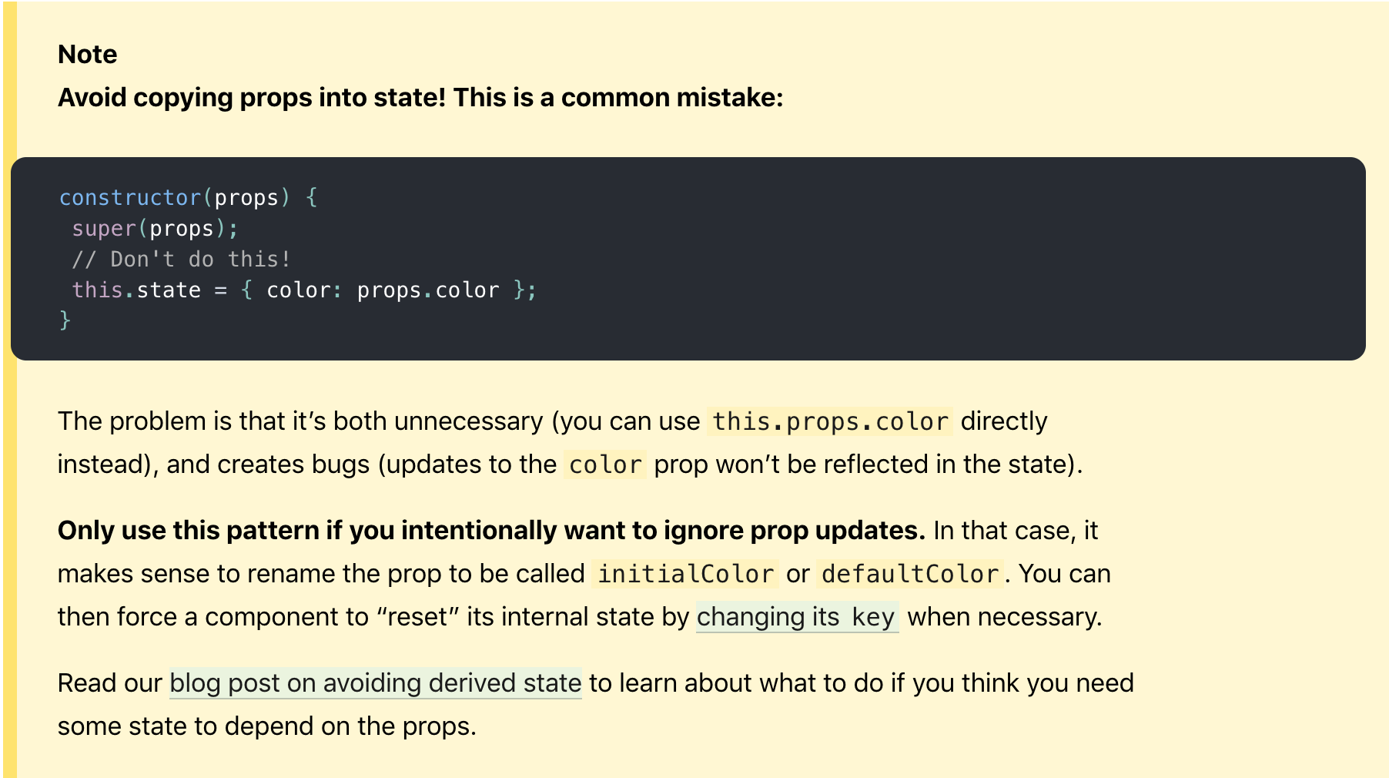

Slide 6
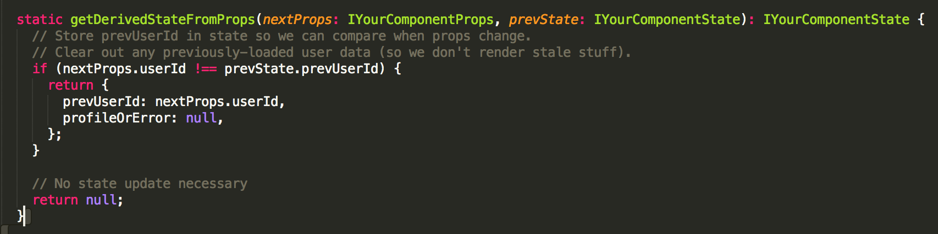
getDerivedStateFromProps
Notes:
getDerivedStateFromProps allows us to provide a function whose only purpose is to update the state based on prop changes, without any side effects. This makes the component as a whole much easier to reason about. getDerivedStateFromProps is invoked right before calling the render method, both on the initial mount and on subsequent updates. It should return an object to update the state, or null to update nothing.

Slide 7
Simpler alternatives:
If you need to perform a side effect (for example, data fetching or an animation) in response to a change in props, use componentDidUpdate lifecycle instead.
If you want to re-compute some data only when a prop changes, use a memorization helper instead.
If you want to “reset” some state when a prop changes, consider either making a component fully controlled or fully uncontrolled with a key instead.

Slide 8
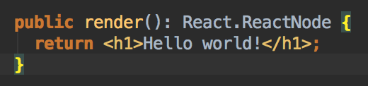
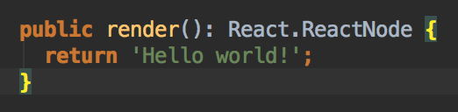
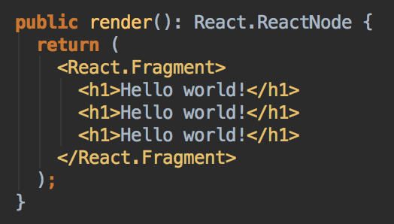
render
The render() method is the only required method in a class component.
Notes:
The render() function should be pure, meaning that it does not modify component state, it returns the same result each time it’s invoked, and it does not directly interact with the browser.
If you need to interact with the browser, perform your work in componentDidMount() or the other lifecycle methods instead. Keeping render() pure makes components easier to think about.

Slide 9
When called, it should examine this.props and this.state and return one of the following types:
React elements. Typically created via JSX. For example, <div /> and <MyComponent /> are React elements that instruct React to render a DOM node, or another user-defined component, respectively.
Arrays and fragments. Let you return multiple elements from render. See the documentation on fragments for more details.
Portals. Let you render children into a different DOM subtree. See the documentation on portals for more details.
String and numbers. These are rendered as text nodes in the DOM.
Booleans or null. Render nothing. (Mostly exists to support return test && <Child /> pattern, where test is boolean.)

Slide 10
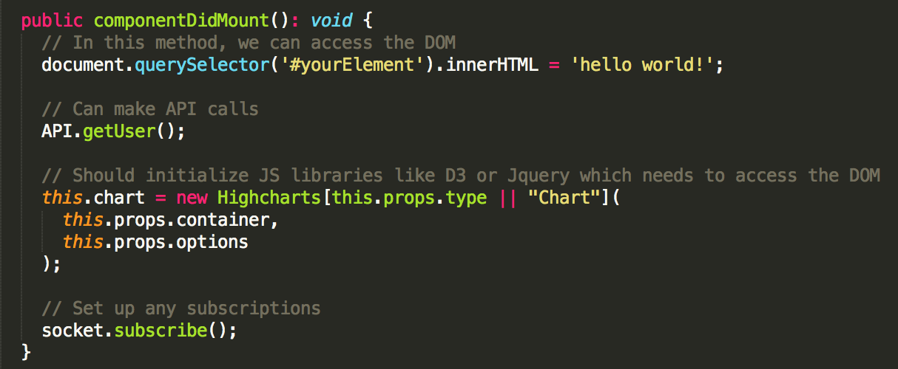
componentDidMount
Notes:
componentDidMount() is invoked immediately after a component is mounted (inserted into the tree). Initialization that requires DOM nodes should go here. If you need to load data from a remote endpoint, this is a good place to instantiate the network request. This method is a good place to set up any subscriptions. You may call setState() immediately in componentDidMount(). It will trigger an extra rendering, but it will happen before the browser updates the screen. This guarantees that even though the render() will be called twice in this case, the user won’t see the intermediate state. Use this pattern with caution because it often causes performance issues.

Slide 11
Updating
An update can be caused by changes to props or state. These methods are called in the following order when a component is being re-rendered:
static getDerivedStateFromProps()
shouldComponentUpdate()
render()
getSnapshotBeforeUpdate()
componentDidUpdate()

Slide 12
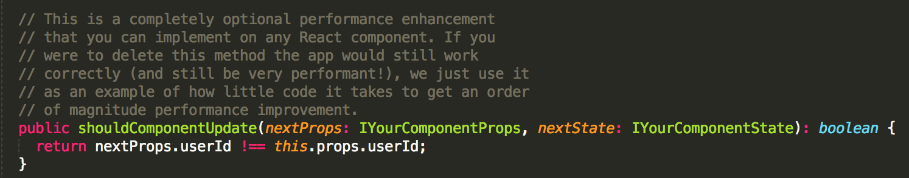
shouldComponentUpdate
If shouldComponentUpdate() returns false, then render(), and componentDidUpdate() will not be invoked.
Notes:
Use shouldComponentUpdate() to let React know if a component’s output is not affected by the current change in state or props. The default behavior is to re-render on every state change, and in the vast majority of cases you should rely on the default behavior. shouldComponentUpdate() is invoked before rendering when new props or state are being received. Defaults to true. This method is not called for the initial render or when forceUpdate() is used. If you are confident you want to write it by hand, you may compare this.props with nextProps and this.state with nextState and return false to tell React the update can be skipped.

Slide 13
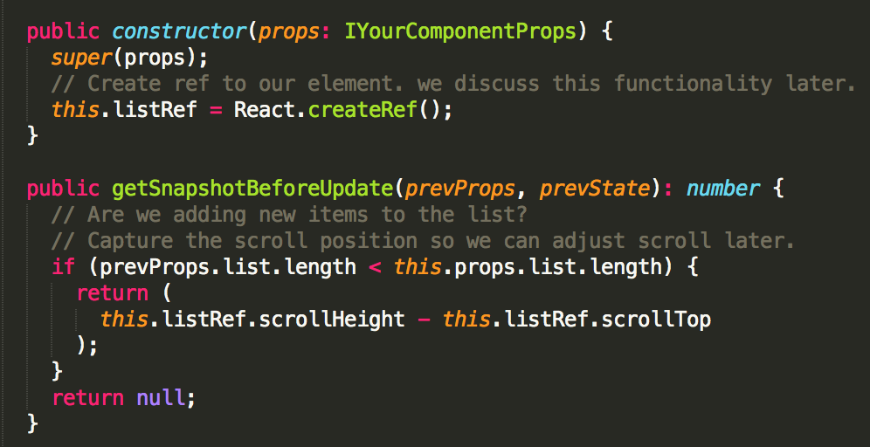
getSnapshotBeforeUpdate
Notes:
getSnapshotBeforeUpdate() is invoked right before the most recently rendered output is committed to e.g. the DOM. It enables your component to capture some information from the DOM (e.g. scroll position) before it is potentially changed. Any value returned by this lifecycle will be passed as a parameter to componentDidUpdate(). This use case is not common, but it may occur in UIs like a chat thread that need to handle scroll position in a special way. A snapshot value (or null) should be returned.
In the above examples, it is important to read the scrollHeight property in getSnapshotBeforeUpdate because there may be delays between “render” phase lifecycles (like render) and “commit” phase lifecycles (like getSnapshotBeforeUpdate and componentDidUpdate).

Slide 14
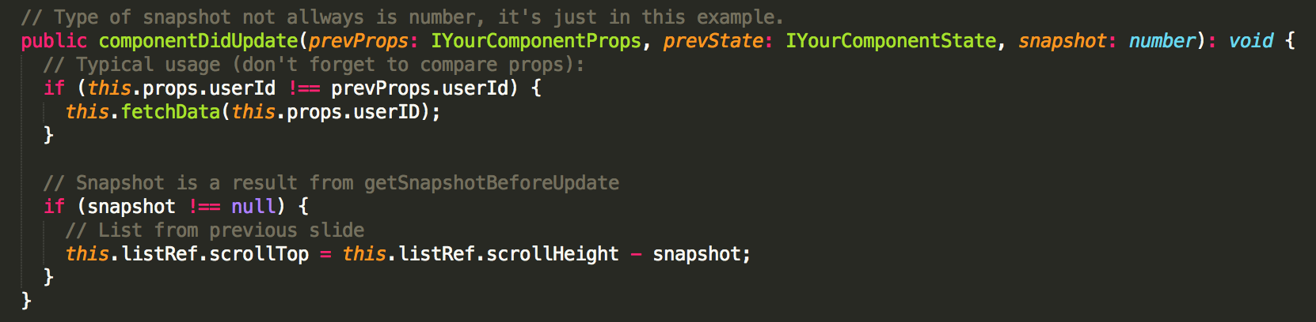
componentDidUpdate
Notes:
componentDidUpdate() is invoked immediately after updating occurs. This method is not called for the initial render. Use this as an opportunity to operate on the DOM when the component has been updated. This is also a good place to do network requests as long as you compare the current props to previous props.

Slide 15
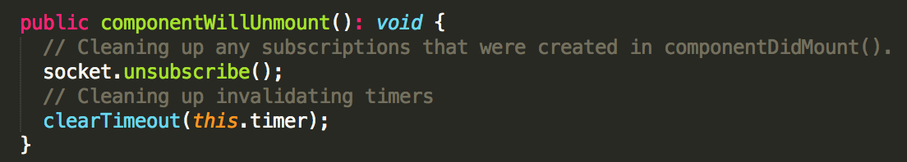
Unmounting
This method is called when a component is being removed from the DOM:
componentWillUnmount()
Notes:
You should not call setState() in componentWillUnmount() because the component will never be re-rendered. Once a component instance is unmounted, it will never be mounted again.

Slide 16

Error boundaries
A class component becomes an error boundary if it defines either (or both) of the lifecycle methods:
getDerivedStateFromError()
componentDidCatch()
Notes:
Error boundaries are React components that catch JavaScript errors anywhere in their child component tree, log those errors, and display a fallback UI instead of the component tree that crashed. Error boundaries catch errors during rendering, in lifecycle methods, and in constructors of the whole tree below them.

Slide 17
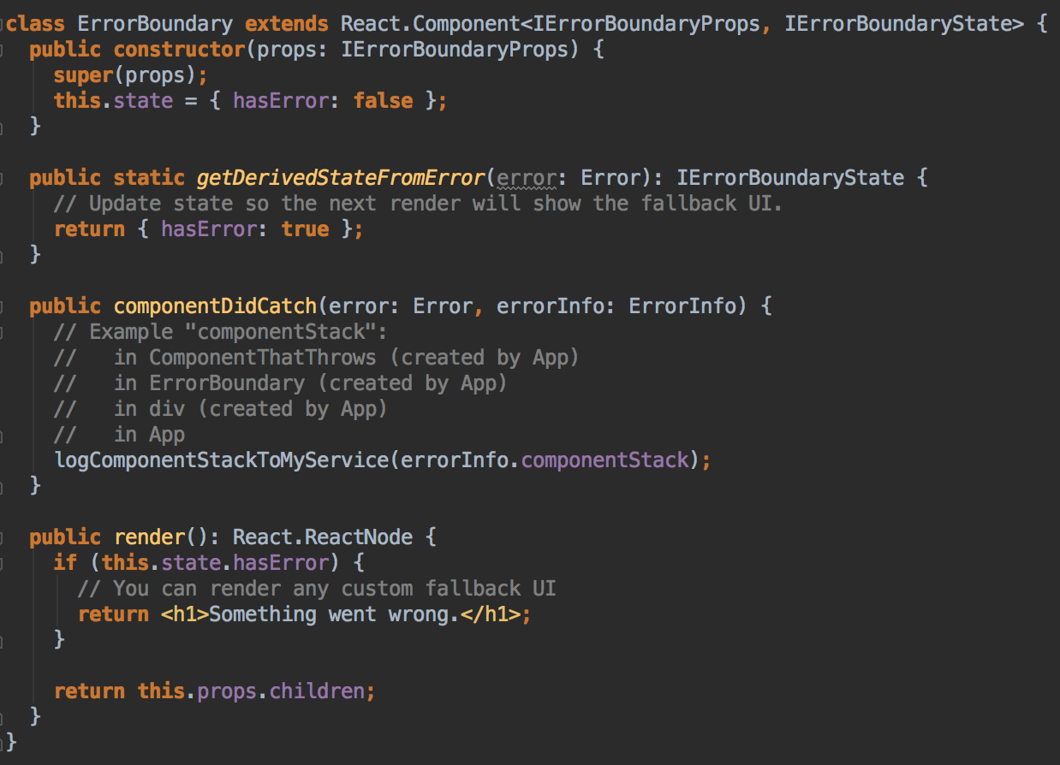
Notes:
getDerivedStateFromError - This lifecycle is invoked after an error has been thrown by a descendant component. It receives the error that was thrown as a parameter and should return a value to update state. componentDidCatch - This lifecycle is invoked after an error has been thrown by a descendant component. It receives two parameters:
1. error - The error that was thrown.
2. info - An object with a componentStack key containing information about which component threw the error.

Slide 18
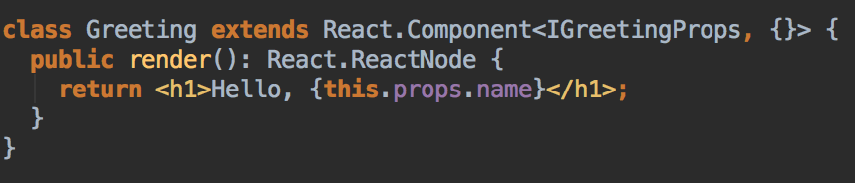
React.Component
React.Component is the base class for React components when they are defined using ES6 classes:

Slide 19
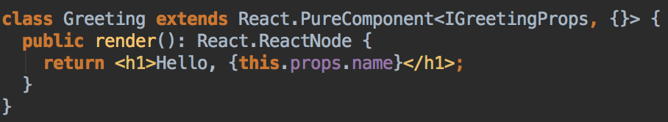
React.PureComponent
Notes:
React.PureComponent is similar to React.Component. The difference between them is that React.Component doesn’t implement shouldComponentUpdate() but React.PureComponent implements it with a shallow prop and state comparison.
If your React component’s render() function renders the same result given the same props and state, you can use React.PureComponent for a performance boost in some cases.
React.PureComponent’s shouldComponentUpdate() skips prop updates for the whole component subtree. Make sure all the children components are also “pure”.

Slide 20
React.Children
React.Children provides utilities for dealing with the this.props.children opaque data structure.
React.Children has next methods:
map
forEach
count
only
toArray

Slide 21
React.Fragment
Notes:
The React.Fragment component lets you return multiple elements in a render() method without creating an additional DOM element:

Slide 22
Context
Context provides a way to pass data through the component tree without having to pass props down manually at every level.
API:
React.createContext
Context.Provider
Class.contextType
Context.Consumer
Notes:
In a typical React application, data is passed top-down (parent to child) via props, but this can be cumbersome for certain types of props (e.g. locale preference, UI theme) that are required by many components within an application. Context provides a way to share values like these between components without having to explicitly pass a prop through every level of the tree. More details you will know in advanced course.

Slide 23
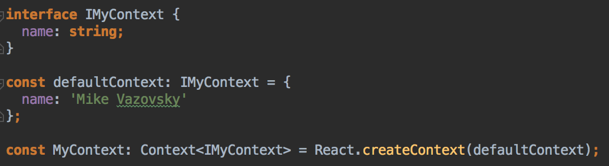
React.createContext
Notes:
Creates a Context object. When React renders a component that subscribes to this Context object it will read the current context value from the closest matching Provider above it in the tree.
The defaultValue argument is only used when a component does not have a matching Provider above it in the tree. This can be helpful for testing components in isolation without wrapping them. Note: passing undefined as a Provider value does not cause consuming components to use defaultValue.

Slide 24
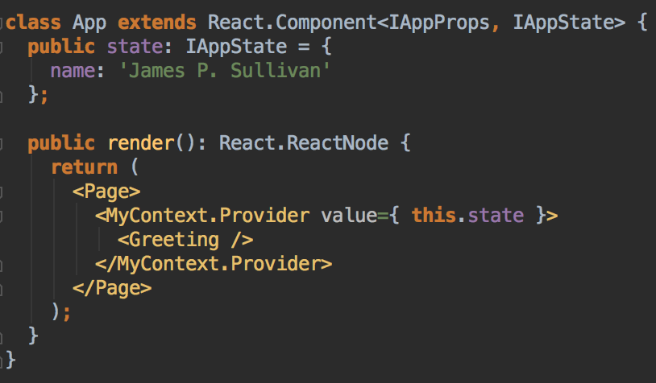
Context.Provider
Notes:
Every Context object comes with a Provider React component that allows consuming components to subscribe to context changes.
Accepts a value prop to be passed to consuming components that are descendants of this Provider. One Provider can be connected to many consumers. Providers can be nested to override values deeper within the tree.
All consumers that are descendants of a Provider will re-render whenever the Provider’s value prop changes. The propagation from Provider to its descendant consumers is not subject to the shouldComponentUpdate method, so the consumer is updated even when an ancestor component bails out of the update.

Slide 25
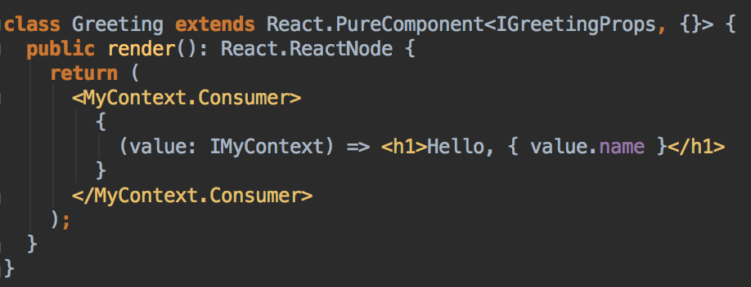
Context.Consumer
Notes:
A React component that subscribes to context changes. This lets you subscribe to a context within a function component.
Requires a function as a child. The function receives the current context value and returns a React node. The value argument passed to the function will be equal to the value prop of the closest Provider for this context above in the tree. If there is no Provider for this context above, the value argument will be equal to the defaultValue that was passed to createContext().

